Slide 1
Automation at High Level

Slide 2
Agenda
What is automation? How is it different from manual
Automation Benefits
Tools commonly used
What is Framework

Slide 3
What is Automation
Automated testing: The management and performance of test activities, to include the development and execution of test scripts having as objective the verification of test requirements, using an automated test tool.
Automated testing is executed by software tools, languages and scripts

Slide 4
What is Automation
Tests that should not be automated are:
Tests that are executed very rare
If the testcases are executed very minimal times
The system is very unstable
It is always best to automate a feature once it has been stabilized and less subject to change.
Tests that can be verified easily manually but hardly automated
Tests that need physical interaction

Slide 5
Benefits of automation
Benefits of Automation-
Tests must be ran repeatedly
A large test matrix
Example- Different languages on different OS platform
Automated tests can be run the same time on different machines
Run with the lights off
Improves ROI
Faster Time-to-Market
Test Automation greatly helps reduce the time-to-market of an application by allowing constant execution of test cases.

Slide 6
Benefits of Automation
Cons of Automation-
Costs - Writing the test cases and writing or configuring the automate framework that is used costs more initially than running the test manually.
Some tests can't be automated – manual tests are needed
Most of the times an Automated Testing system can't tell if something "looks good" on the screen or when a pictogram or a window is not displayed well
Maintenance Time and Effort- you will need to spend the time upgrading the relevant tests as the application is upgraded.
False sense of quality-All automated checks in a test suite can happily pass, but there could be major flaws undetected

Slide 7
Automation Tools
Selenium
Autoit
Sikuli
Robot framework

Slide 8
Selenium
Selenium is a web Automation tool which can be used to automate web browsers across many browsers and operating systems.
Locators provide a way to access the HTML elements from a web page
Eight ways to use Locators for Selenium Testing
Inbuilt reporting mechanism
Allows scripting in several languages like Java, C#, PHP and Python.
Supports Cross Browser Testing. The Selenium tests can be run on multiple browsers.

Slide 9
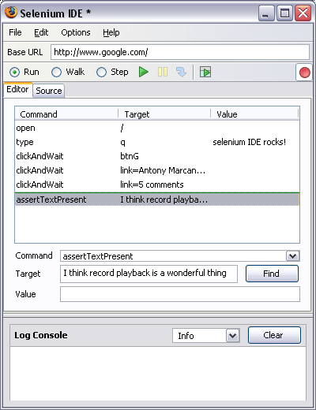
Selenium Components
Integrated development environment for Selenium
Enables you to record a browser session
Implemented as a Mozilla FireFox extension
Allows you to record, edit, and debug tests

Slide 10
Selenium Components
Selenium WebDriver-
Most powerful and popular tools of Selenium toolkit
WebDriver extends its support to many latest browsers and platforms.
WebDriver also doesn’t require Selenium server to be started prior to execution of the test scripts, unlike Selenium RC.
support dynamic web pages and Ajax calls.
WebDriver doesn’t readily support new browsers
Selenium WebDriver supported programming languages are –
Java, C#, PHP, Perl, Ruby and Python

Slide 11
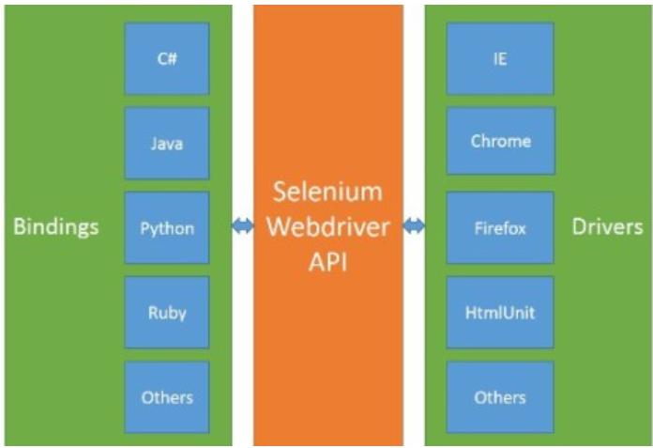
Selenium WebDriver

Slide 12
Selenium Locators
Id To Select The Element With A Specified @Id Attribute
<input id="user" class="required" type="text">
WebElement item = driver.findElement(By.id("user"));
Name To Select The First Element With The Specified @Name Attribute
<input id="user" name="admin" class="required" type="text">
WebElement locator = driver.findElement(By.name("admin"));
Link Text To Select The Link Element Which Contains The Matching Text
<a href="http://www.google.com">How to use locators?</a>
WebElement item = driver.findElement(By.linkText("How to use locators?"));

Slide 13
Selenium Locators
Partial Link Text To Select Link (Anchor Tag) Element Which Contains Text
Matching The Specified Partial Link Text.
<a href="http://www.google.com">How to use locators?</a>
WebElement item = driver.findElement(By.PartialLinkText("How to use
locators?"));
Tag Name To Find The Element Using Its HTML Tag.
List<WebElement> linkElements = driver.findElements(By.tagName("results"));
String[] linkTexts = new String[linkElements.size()];
CSS Class Name To Access The Elements
WebElement element =driver.findElement(By.className(“sample”));

Slide 14
Selenium Locators
CSS Selector To Access The Elements
WebElement CheckElements = driver.findElements(By.cssSelector("input[id=email']"));
XPath To Track An Element Using The XPath Expression.
HTML/head/body/table/tr/td – Absolute
//table/tr/td - Relative

Slide 15
Selenium Grid
Selenium Grid is a dynamic tool that can distribute and run the Selenium tests across many physical/virtual machines in a concurrent order
Able to test process across different browsers
Simultaneous execution of Selenium RC/Webdriver tests in different browsers and on a variety of the operating systems.
Run a large Selenium test suite and to finish it in the shortest possible timeframe

Slide 16
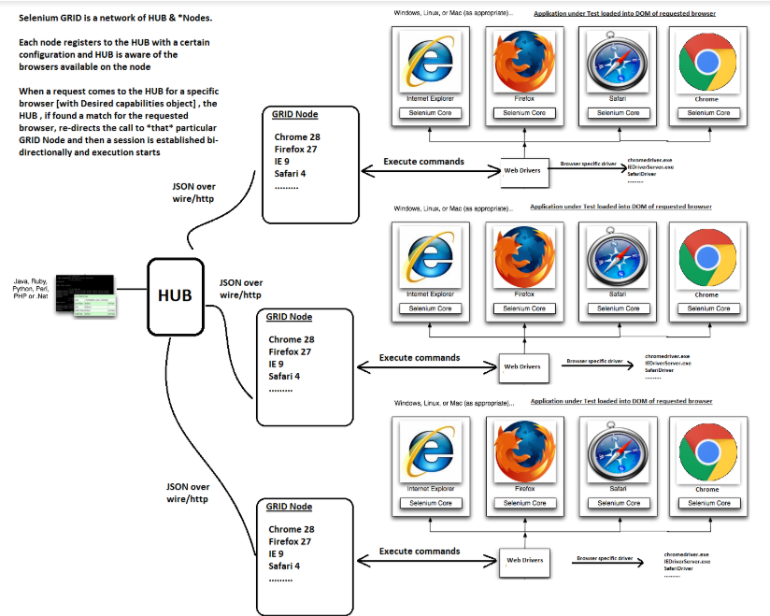
Selenium Grid
Selenium Grid architecture consists of a Hub and a Node

Slide 17
AutoIt
AutoIt v3 is a freeware BASIC-like scripting language designed for automating the Windows GUI and general scripting.
Features of AutoIt
Easy to learn BASIC-like syntax
Simulate keystrokes and mouse movements
Manipulate windows and processes
Interact with all standard windows controls
Scripts can be compiled into standalone executables
Create Graphical User Interfaces (GUIs)
COM support
Regular expressions
Directly call external DLL and Windows API functions
Scriptable RunAs functions
Detailed help file and large community-based support forums
Compatible with Windows 95 / 98 / ME / NT4 / 2000 / XP / 2003 / Vista / 2008
Unicode and x64 support

Slide 18
AutoIt
Download Latest Installer for AutoIt:
http://www.autoitscript.com/cgi-bin/getfile.pl?autoit3/autoit-v3-setup.exe
SciTE is a Scintilla based Text Editor

Slide 19
Sikuli
GUI level (image recognition)
SikuliX allows one to automate visual workflows
Open source
Supported scripting languages
Python
Java
Ruby
Exist a Recorder
Supports on Linux, Windows and Mac

Slide 20
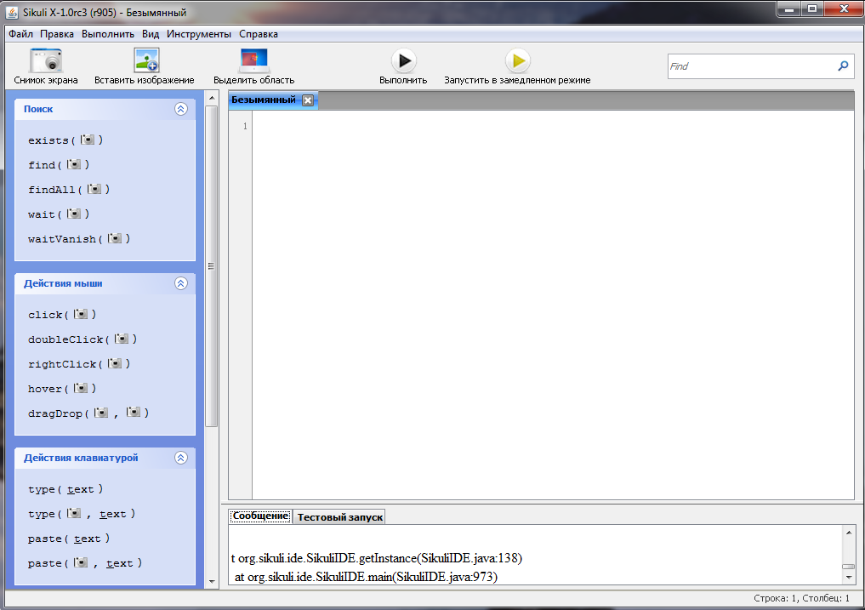
Sikuli

Slide 21
Robot Framework
Robot Framework is a Keyword Driven automation framework using Python or Java as it's backend.
Test cases are automated by writing steps using Robot framework keywords.
Provides a simple library API for creating customized test libraries.
Provides a command line interface and XML based outputs for integration into existing build infrastructure (continuous integration systems).
Report files created as a result of every pybot execution: report.html, log.html, output.xml.
Use RIDE(Robot IDE)
Implemented with Python
– Runs also on Jython (JVM) and IronPython (.NET)
– Can be extended natively using Python or Java
– Other languages supported via a remote interface

Slide 22
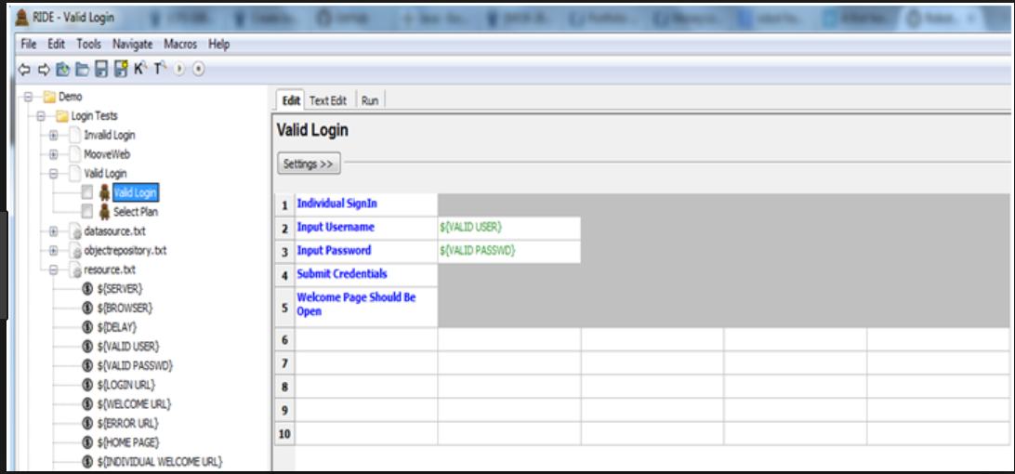
Robot Framework

Slide 23
Automation Framework
What is Automation Framework- A set of guidelines like coding standards , test-data handling , object repository treatment etc... which when followed during automation scripting produce beneficial outcomes like increase code re-usage , higher portability , reduced script maintenance cost etc.
Types of Automation Framework-
Data Driven Automation Framework
Keyword driven Automation Framework
Hybrid Automation Framework

Slide 24
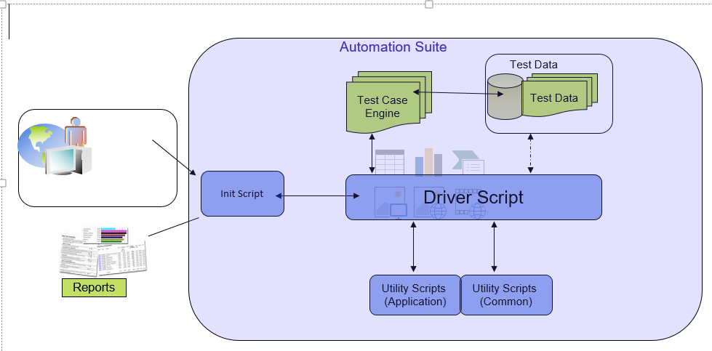
Automation Framework

Slide 25
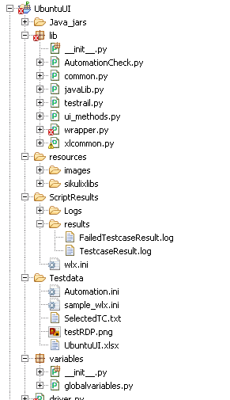
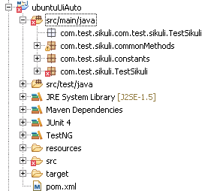
Automation Framework

Slide 26
Thank you

